Slide 1


TubesNxt
Fake Test Certificate Prevention Solution | Way Forward
Notes:
Change logo

Slide 2






Agenda
1. Problem Statement
Counterfeit TCs harm revenue, trust, and brand reputation.
2. Implemented Process
Distributor orders, manufacturer delivers goods with Test Certificate
3. Process Flow Diagram
Illustration of how TCs are currently managed
4. Benefits of Implemented Process
Enhanced security & transparency
5. Way Forward
AI/ML Integration, user friendly, scalable, and blockchain secured.
6. Conclusion
Trusted, scalable platform securing products, boosting efficiency, brand value, and convenience.

Slide 3




Problem Statement
Proliferation of Counterfeit Products
Misuse of Brand Reputation
Threat to Brand Image
Revenue Loss
Lack of secure verification allows fake products to enter the market.
Counterfeiters leverage TSL’s brand by selling unauthorised, low-quality products.
Forged certificates damage TSL’s reputation and consumer trust.
Demand & supply have been fulfilled by counterfeit products.

Slide 4
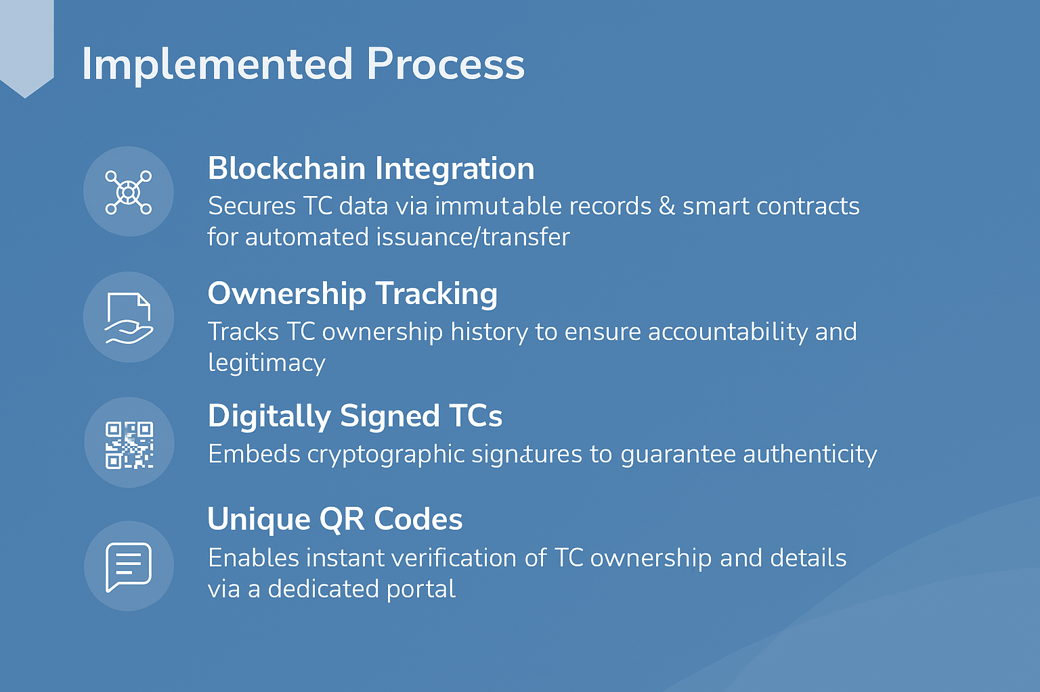

Implemented Solution
Hyperledger Fabric Framework
Permissioned blockchain allowing access only to authorized entities.
Inventory Insights for Distributors
TC-linked data helps plan, track, and reorder efficiently.
Immutable Audit Trail
Every TC action—issuance, linking, and verification—is permanently recorded for full traceability.
Ownership Tracking
Tracks TC ownership history to ensure accountability and legitimacy.
Digitally Signed TCs
Embeds digital signatures to guarantee authenticity.
Digitally Ecosystem
Unified platform connecting TSL, distributors, & buyers.

Slide 5







Process Flow Diagram
Distributor Internal System
Distributor places PO
Tata Steel’s SAP system
Receives PO information
Generates Invoice
TC data is prepared
Vara’s TubesNxt Platform
Portal displays relevant details
Buyer can verify the TC
Buyer is linked to TC
Test Certificate created
Data received by platform

Slide 6






Benefits of Implemented Solution
Enhanced Security
Tamper-proof TCs via blockchain and digital signatures eliminate forgery risks.
Transparent Ownership Tracking
Full audit trail of TC transfers ensures accountability across the supply chain.
Seamless Integration with Existing Systems
Easy adoption without disrupting core operations.
Brand Protection
Prevents misuse of TSL’s reputation by blocking fake products.
Operational Efficiency
Automated smart contracts reduce manual errors and streamline TC issuance.
Customer Trust
Transparent verification fosters confidence in TSL’s products and brand.

Slide 7






Key Platform Enhancements since Dec’24
TC Data Validation Enhanced
Resolved issues related to incorrect TC data from SAP
Admin-based Approval Process
Admin is now authorised to approve updates of the dealer profiles.
Industry Segment Management
Industry segmentation added to dashboards.
Smart OTP Logic for Bulk Issuance
One OTP supports up to 3 TC generations.
TC Return Flow Fixed
Resolved issues related to return of multiple TCs.
Dashboard Performance Optimized
Manufacturer dashboard performance improved.

Slide 8



Way Forward – TubesNxt V2
Smart Sales Insights
By analyzing TC generation and buyer patterns, we will give TSL’s sales and marketing teams real-time dashboards to track product movement by region, distributor, or customer.
User-Friendly Interface
Redesigned interface for intuitive navigation
Role-based dashboards tailored for TSL, distributors, and buyers.
Simplify TC claiming and linking.
Inventory Management
Predictive demand forecasting using TC trends.
Auto low-stock alerts & anomaly detection for inventory–TC mismatches.
Product Journey
Enhanced visibility into product journeys for buyers through QR codes to access its entire history, including origin and production details.
Intelligent Alerts
Multi-channel notifications for various reports of inventory, sales and certificate updates, with role-based customization.
Support & Onboard
AI chatbot for FAQs
Ticketing for reissues/disputes
Onboarding tools covering KYC and training.

Slide 9
Methodology for TubesNxt V2 Implementation
Microservices Architecture
Blockchain Integration in TubesNxt V2
Product Adapter
Dedicated Support Workflow
AI/ML Integration
Weekly/Monthly Reports

Slide 10
Conclusion
Scalable, Future-Ready Platform
Seamless Stakeholder Experience
Strategic Differentiator for Tata Steel
Adaptable architecture to support more product lines, AI features, and integrations.
Enhanced dashboard, alerts, and verification tools improve usability for all users—manufacturers, dealers, and buyers.
TubesNxt evolves into a universal, verifiable certification standard in the steel industry.

Slide 11

THANK YOU
MUMBAI | GURUGRAM | KOLKATA
Follow us
www.varatechnology.com

